Slide 1
Research Portfolio
Lucia Diaz, PhD
Senior Researcher in Human-Centered Studies
Seattle, WA
June 2025

Slide 2
Table of contents
1.
2.
3.
4.
5.
ABOUT ME
RESEARCH METHODS
CASE STUDY 1
CASE STUDY 2
CONTACT DETAILS

Slide 3
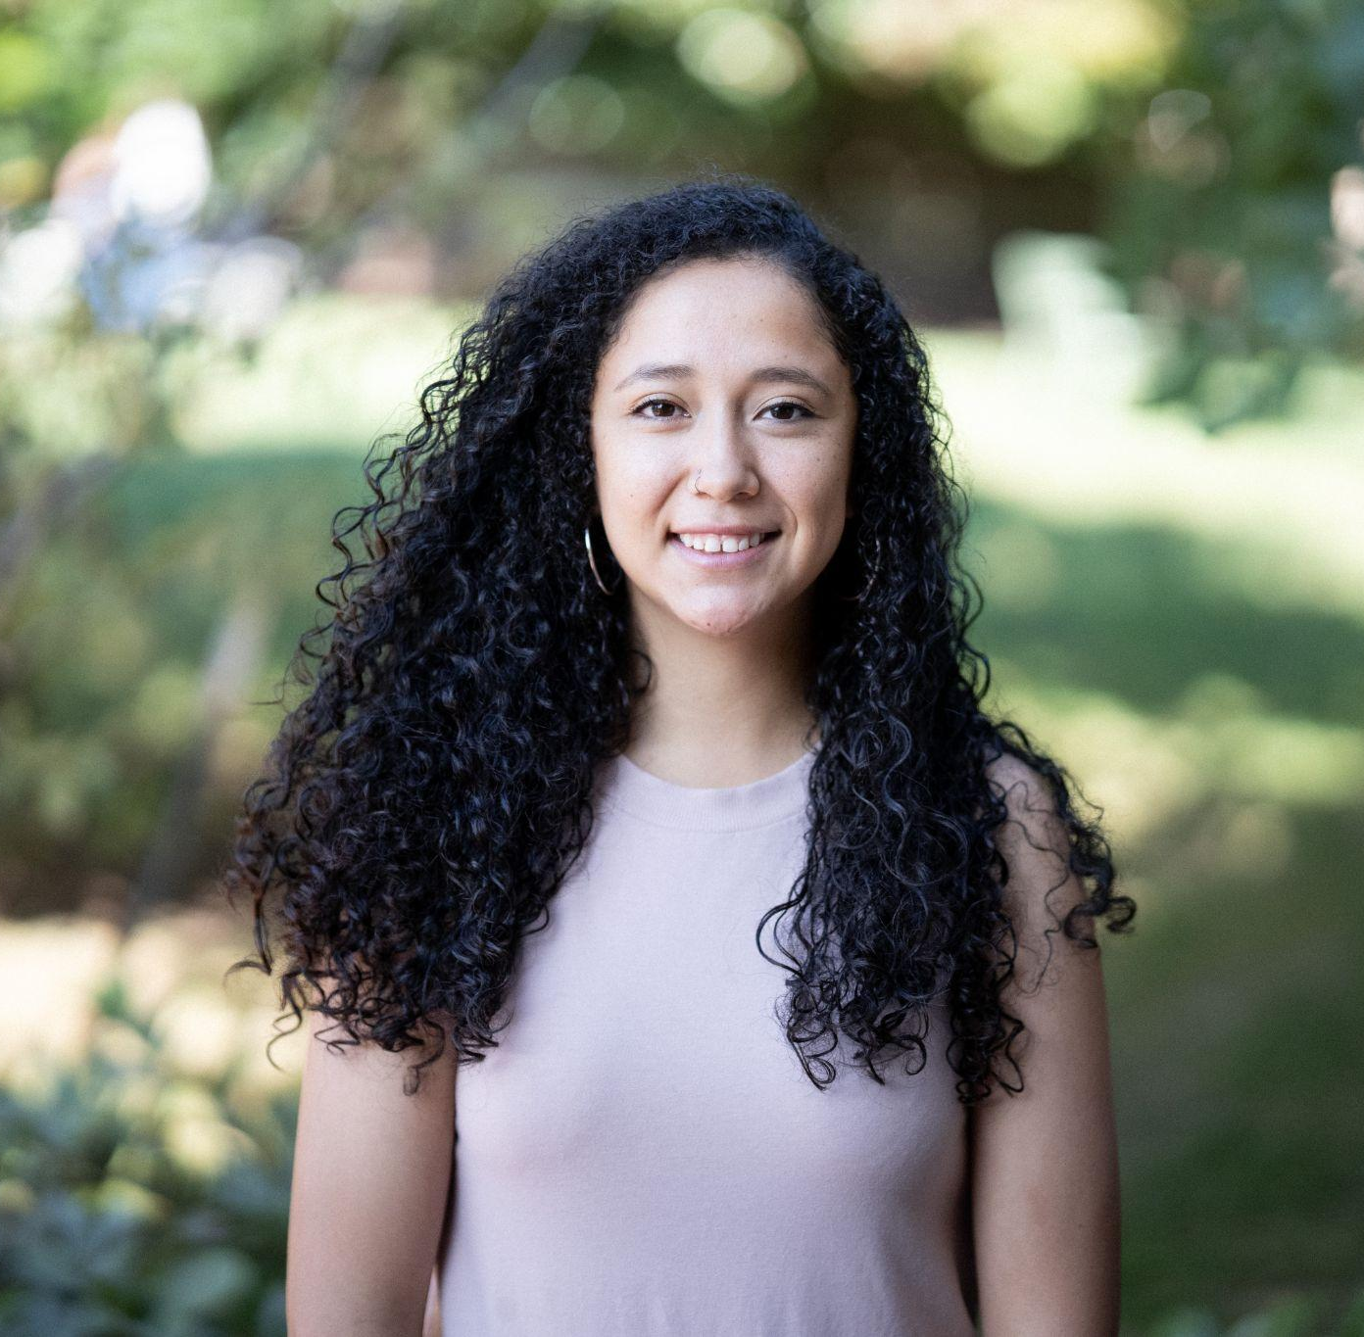
1.
ABOUT ME
I am a Mixed-Methods Researcher with Ph.D. in Anthropology specializing in experimental design, project management, and stakeholder collaboration.
I have demonstrated success in analytical research, mentoring teams, and adapting complex findings for non-technical audiences.
Seeking to apply analytical and communication expertise to support strategic businesses and build high-performing teams.

Slide 4
My key skills:
Leadership
Problem-solving
Communications
I’ve led multi-disciplinary teams of 15+ people in the field and mentored students in the laboratory and classroom.
I solve difficult issues using creative solutions
I can effectively convey complex ideas and concepts to non-technical audiences, students, and professionals.
Organization
Technical skill
Collaboration
Prioritize tasks according to objectives and deadlines.
I’m an expert in experimental design, grant writing, scientific methods, and archival ethnographic research.
Teamwork and collaboration is essential for creating holistic experiences and supporting positive project outcomes.

Slide 5
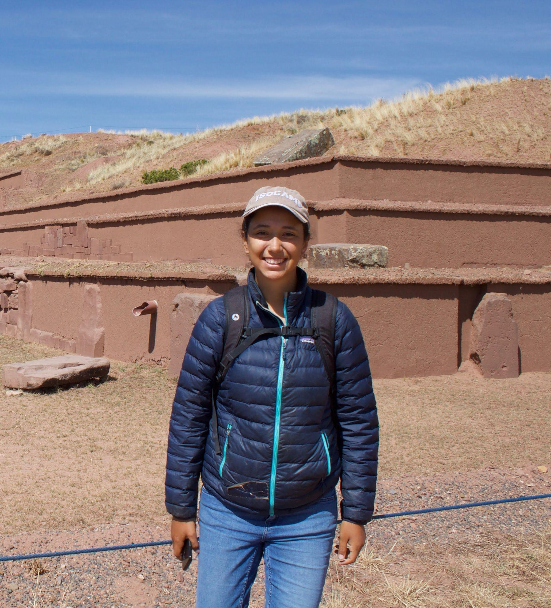
2.
Research Methods
As a Mixed-Methods Researcher with a background in Anthropology, I use both qualitative and quantitative methods to enhance project goals. Here are some methods I’ve used:
Experimental Design
Statistics (ANOVA, T-tests)
GIS Mapping
Archival Research
Data Visualization (Rstudio, Python, PPT)
Meta-data Analysis

Slide 6
My Research Process:
Step 1
Step 2
Step 3
Step 4
Identify objectives
Background research and preparation
Workshop and experimental design
Testing, Experimenting, & prototyping
Step 5
Step 6
Step 7
Data Analysis
Report findings
Outline future steps

Slide 7
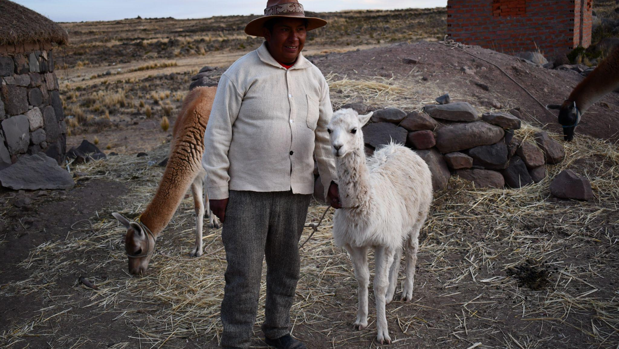
CASE STUDY 1
Big Data & Archival Research:
Human and animal interactions in South America

Slide 8
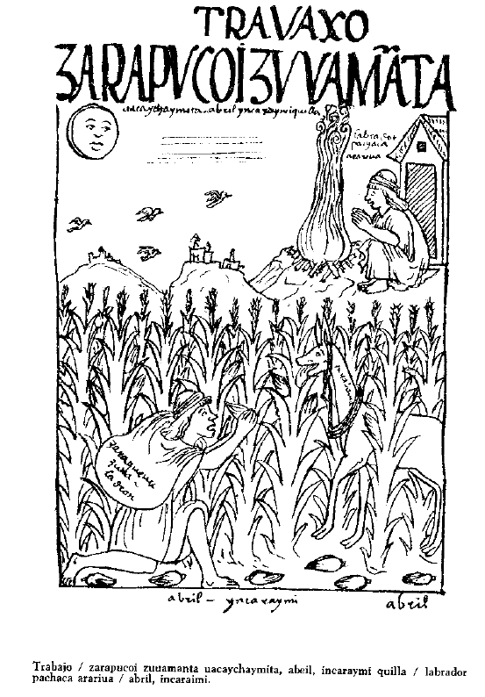
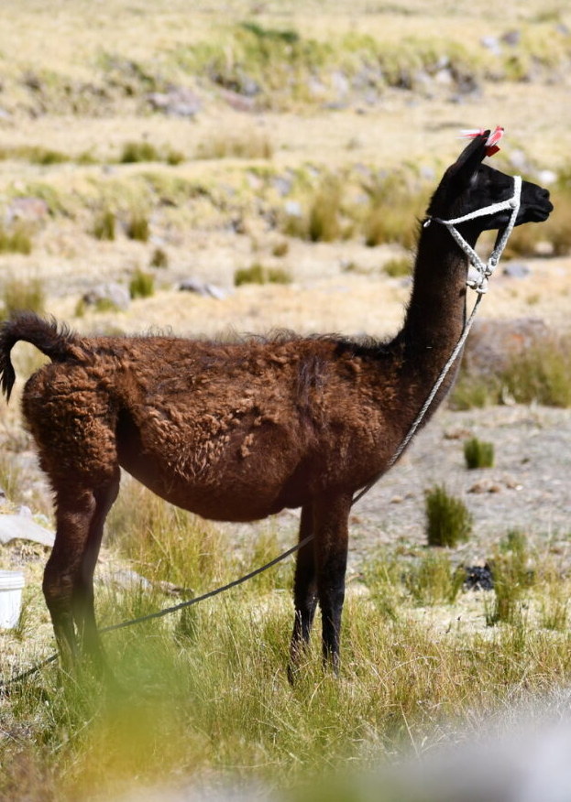
Project Overview
Illustration from archival record
(Guamán Poma de Ayala, 1567[1980]:455).
Exploring human-animal-environmental interactions to understand long- and short-term changes in herding strategies and identify underlying patterns.
Background
Herding practices evolve over time as states expand or collapse and landscape changes.
Objectives
Reconstruct animal diet and mobility to understand how they were herded in the past.
Compare to ethnographic studies on animal practices in Peru and Bolivia.
Outcomes
Access to herding areas were impacted by extreme climatic and political conditions.
Andean pastoral communities are resilient and adaptive, grounded in generations of traditional knowledge.
Photo taken while conducting field work.
Case study 1: Big Data & Archival research

Slide 9

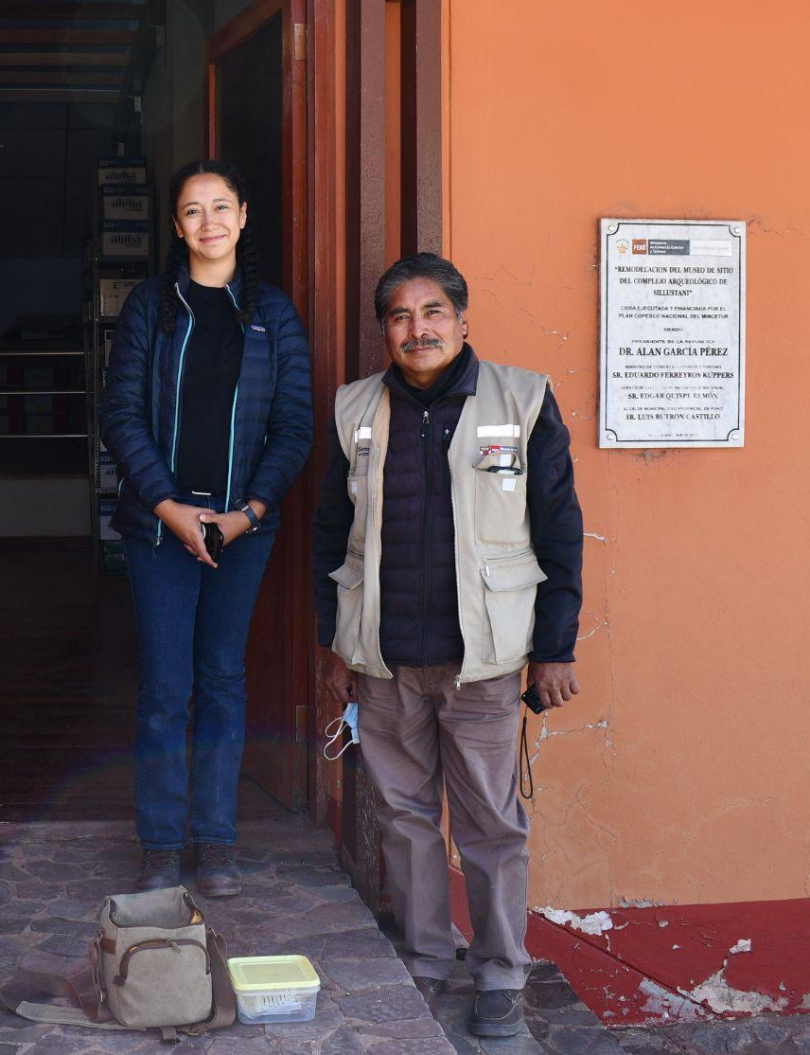
Research Setup:
Created a database of published and newly analyzed camelid carbon and nitrogen isotope values (n = 504) to reconstruct diet and mobility patterns.
Performed in-depth archival research, analyzing ethnographies and historical documents to gain insights into human behavior, social systems, and lived experiences over time.
Statistical tests were performed using SPSS to assess patterns among differing sites, chronologies, settlement pattern, and political affiliation.
Big Data & Archival Analysis
Data Synthesis & Reporting
Designed a database of modern and archaeological plant types (n = 292) in South America by ecological zones, altitude, and photosynthetic pathway.
Collaborated with stakeholders.
Communicated findings to institution, funding agencies, and stakeholders.
Case study 1: Big Data & Archival research

Slide 10
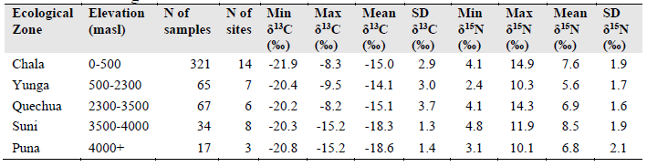
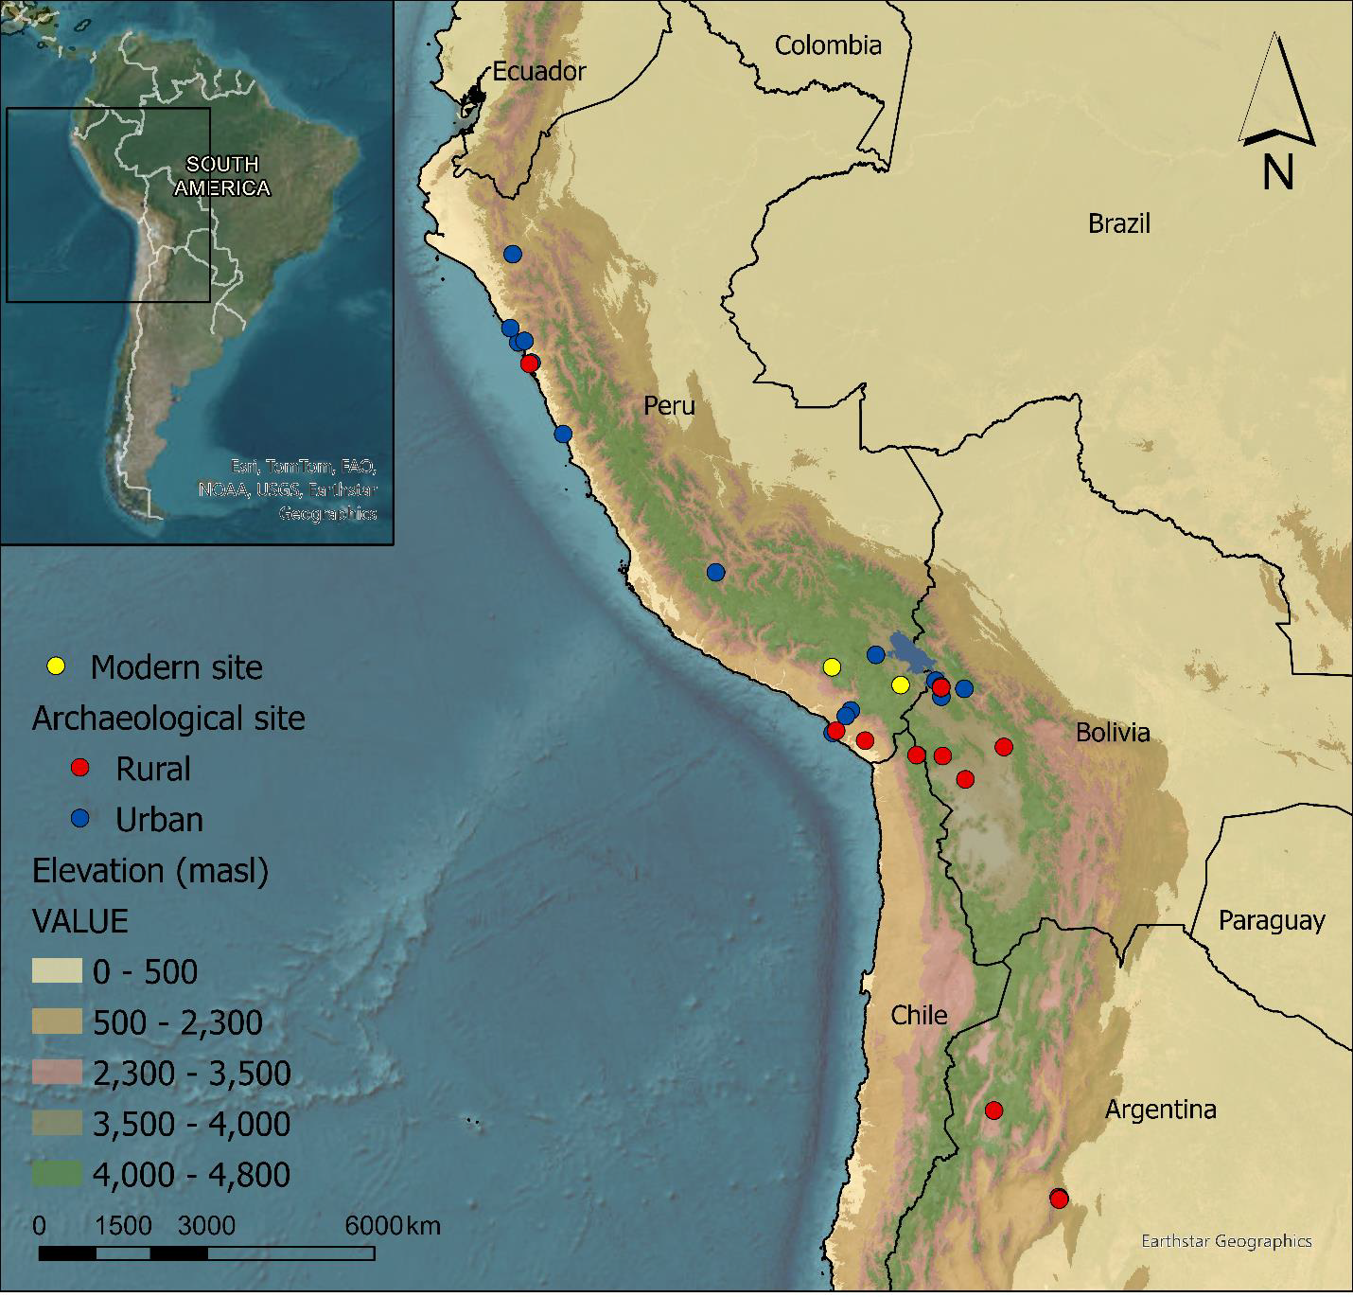
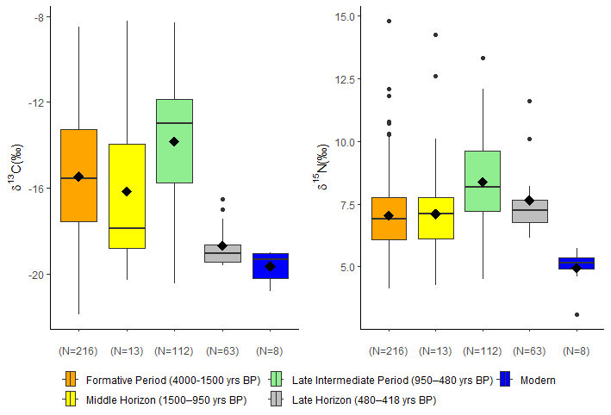
Data Visualization & Reporting:
Mapped each site using ArcGIS based on settlement type and elevation.
Created graphs and tables using Excel and Rstudio.
Conducted statistical analyses including T-tests, summary statistics, Kruskal-Wallis H tests, and Mann Whitney U tests.
Summary statistics using SPSS and Excel
Map created using ArcGIS Pro including elevation (masl) and settlement type.
Graph created using Rstudio highlighting changes over time.
Case study 1: Big Data & Archival research

Slide 11
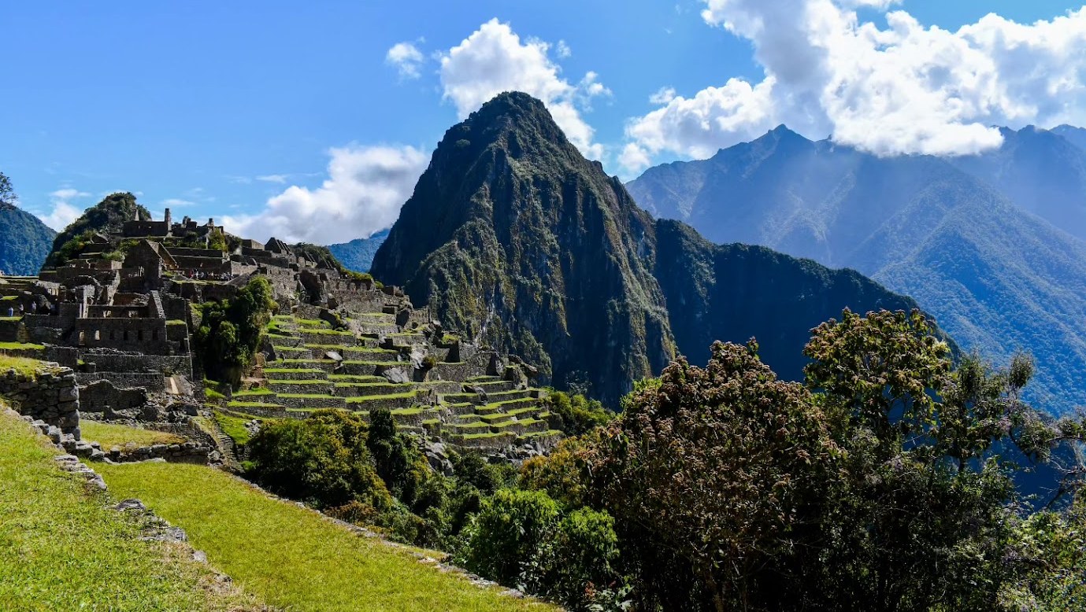
CASE STUDY 2
Scientific Research:
A Deep Dive into Herding Practices in the Ancient Andes

Slide 12

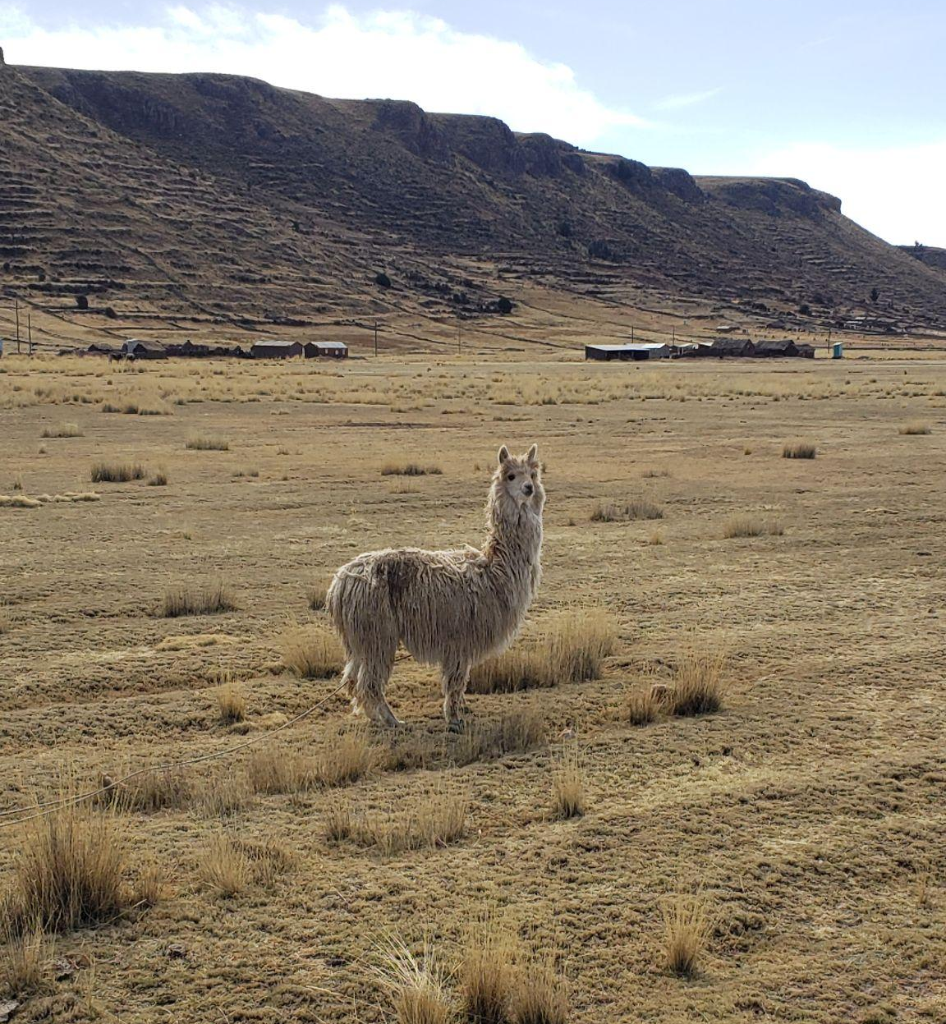
Project Overview
Led a collaborative research project focused on understanding animal management practices in ancient communities in Bolivia and Peru.
Background
Herding practices evolve over time as states expand or collapse and as the environment changes.
Objectives
Using scientific methods to study patterns in how animals were raised and moved across regions during state expansion.
Outcomes
Access to animal grazing areas was shaped by both harsh climate events and interactions with neighboring communities.
Andean pastoral communities engaged in animal management strategies that are no longer practiced today.
Case study 2: Scientific research

Slide 13

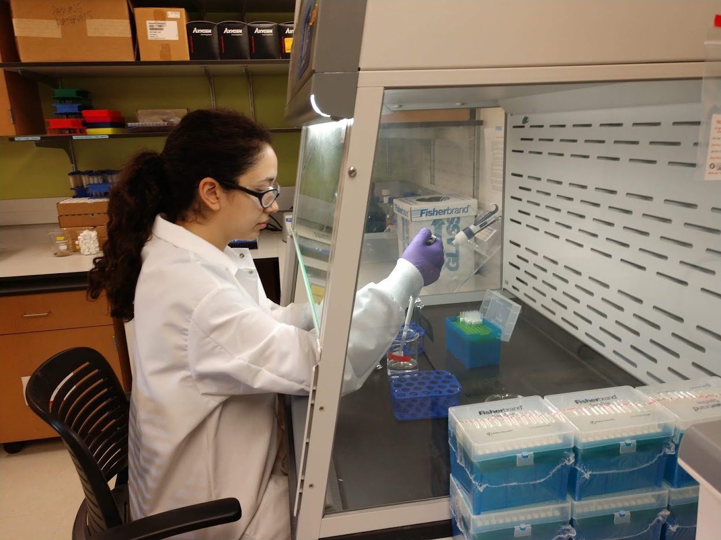
Research setup:
Experimental Design
Designed the research approach in collaboration with archaeologists and stakeholders, ensuring the study aligned with cultural and scientific goals.
Acted as project manager, coordinating communication and tasks across a cross-functional team based in the U.S. and Bolivia. Including:
Keck Carbon Cycle AMS Facility at UC Irvine
Fike Lab at Washington University in St. Louis
W.M. Keck Isotope Laboratory at the UC Santa Cruz
Collasuyo Archaeological Research Institute (CARI)
Data Analysis
I conducted scientific methods on ancient camelid animal remains (n = 165) from 14 specimens.
Conducted similar experiments with modern comparative samples (n = 82) from 5 specimens.
Statistical and data analysis were performed using SPSS, Rstudio, and Excel.
Case study 2: Scientific research

Slide 14
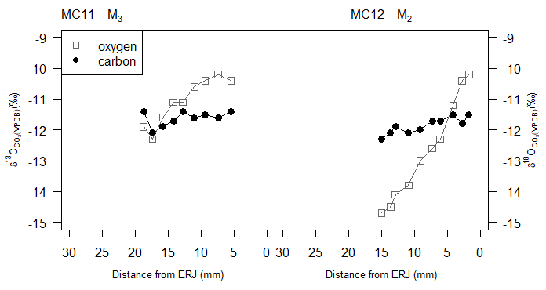
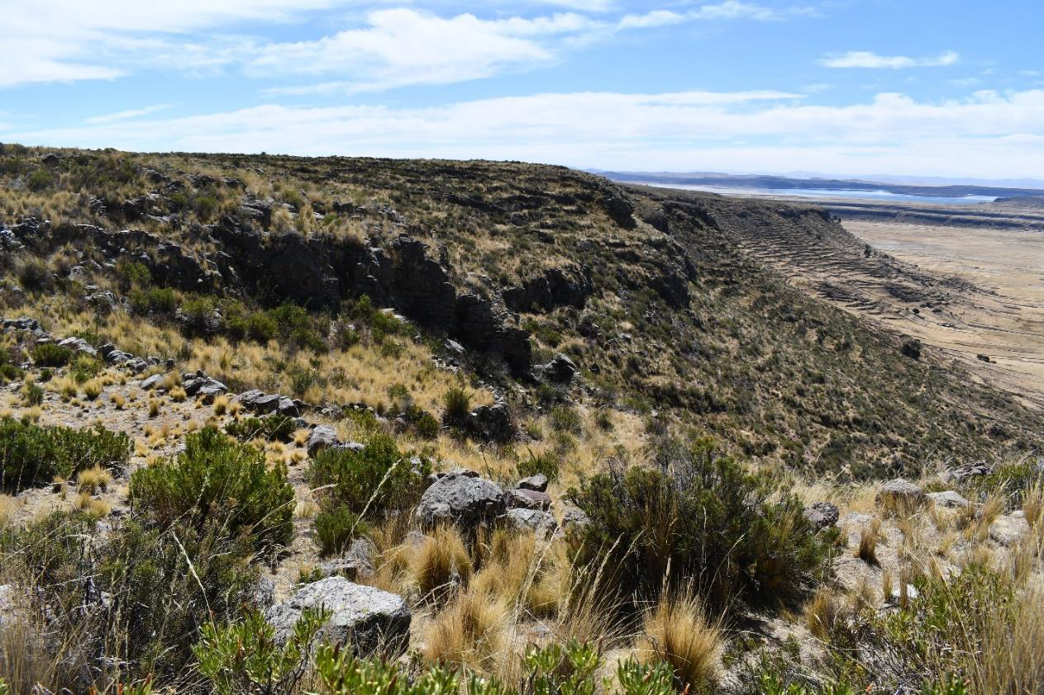
Key Insights:
Future steps:
Herders from these highland communities engaged in traditional animal management practices by utilizing their knowledge of the surrounding landscape for grazing their herds in preferred pastures.
Qualitative and quantitative data are both useful for fully understanding human behaviors and motivations.
Sociopolitical and environmental factors play a major role in daily activities.
Cross-functional collaboration and holistic feedback are helpful for driving successful projects.
Scientific diagram using Rstudio: Reconstruction of animal diet and mobility over time using biogeochemistry methods.
Publish results in both English and Spanish to disseminate findings.
Future project ideas:
Conducting surveys and in-depth interviews with herders to document changes over time.
Photo taken of present-day landscape in Peru
Case study 2: Scientific research

Slide 15
Thank You!
Do you have any questions?
Contact me:
luciamargdiaz@gmail.com
LinkedIn.com/in/luciamdiaz
.
Additional illustrations by Storyset.

